Slide 1
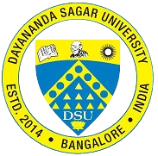
MAJOR PROJECT STAGE 1 2nd REVIEW (20CA3503) TOPIC- OPTICAL CHARACTER RECOGNITION GUIDE: Dr. Vasanthi Kumari P DATE- 16/11/2022
TEAM MEMBERS
SHREYA JAISWAL [ENG20CA0042]
NANDINI GARG [ENG20CA0023
From- BCA 5th Sem
Notes:
nanu

Slide 2
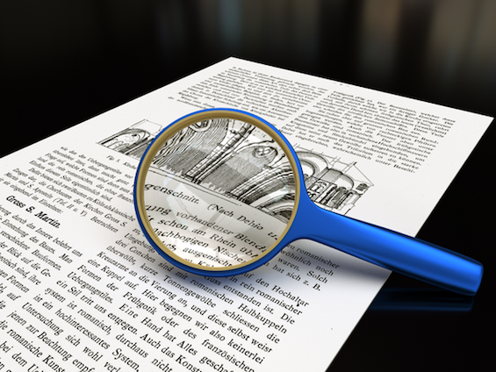
OVERVIEW
Synopsis
Objective
Introduction
State of the art work
Problem statement
Existing system
Proposed system
UML diagrams
Methodology
System Requirements
Conclusion
Future scope
References
Notes:
nanu

Slide 3
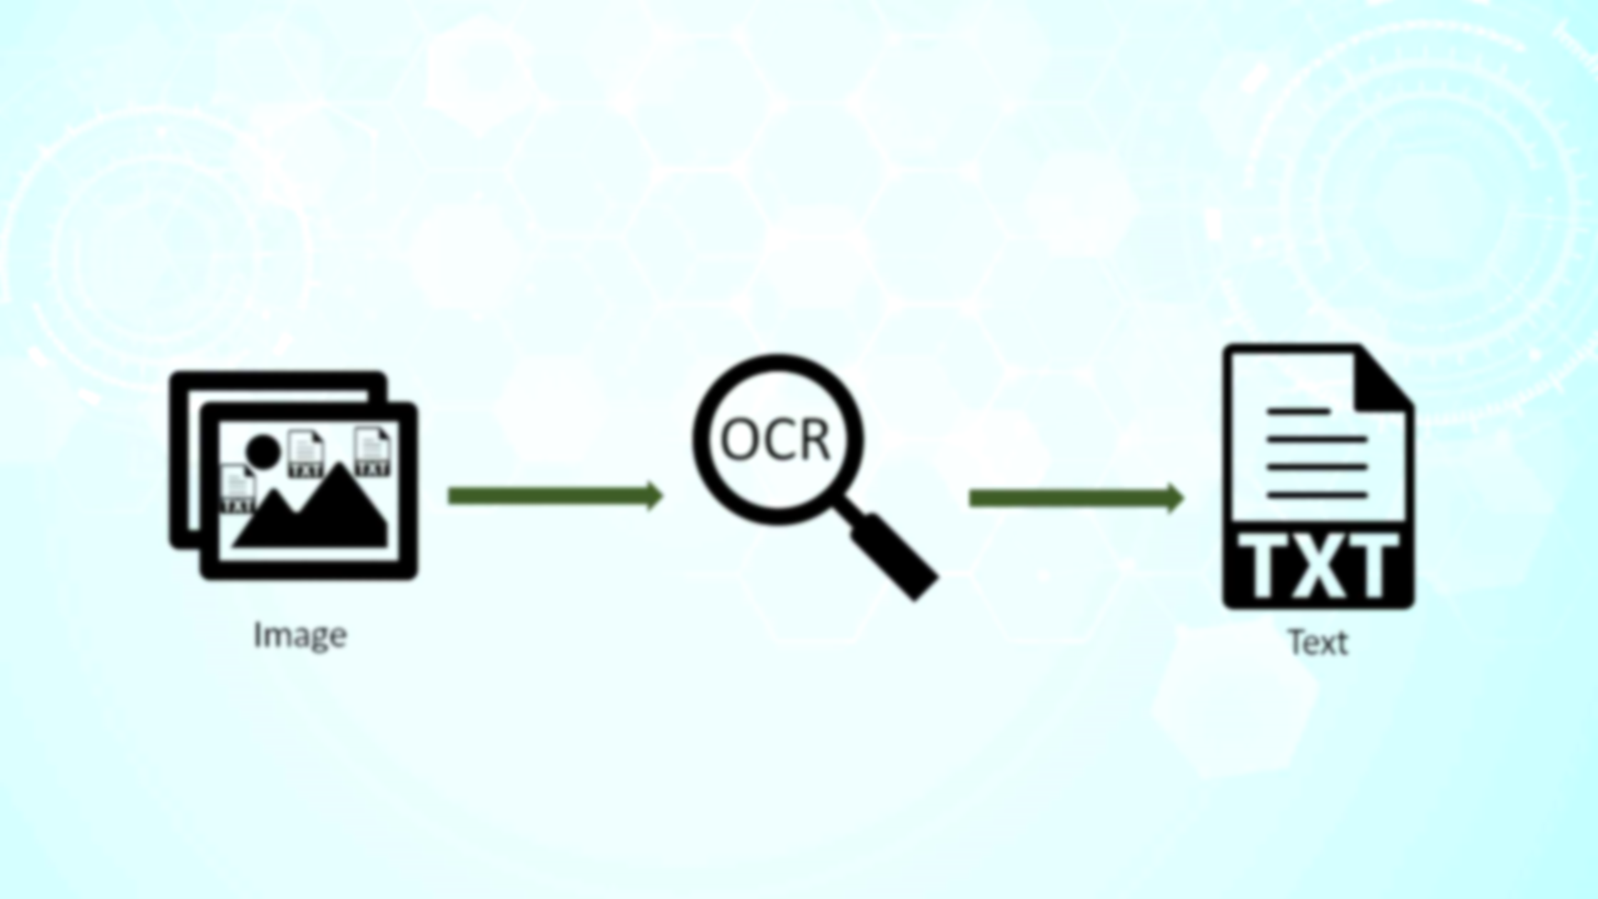
SYNOPSIS
OCR is a technology that analyzes the text of a page and turns the letters into editable letters that may be used to process information. OCR is a technique for detecting printed or handwritten text characters inside digital images of paper files, such as scanning paper records (optical character recognition)
Notes:
nanu

Slide 4
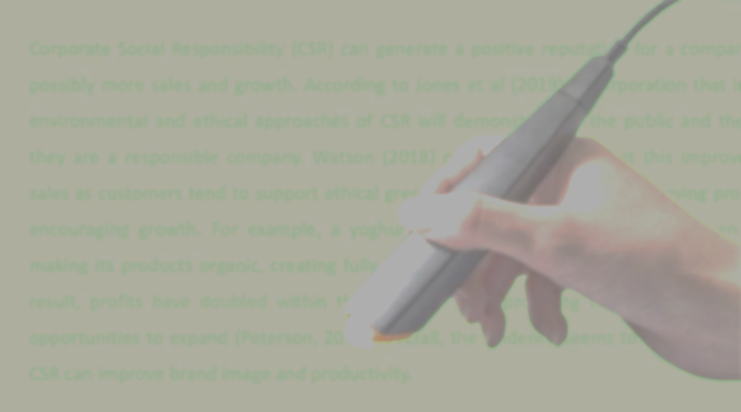
ABSTRACT:
In many different fields, there is a high demand for storing information to a computer storage disk from the data available in printed or handwritten documents or images to later re-utilize this information by means of computers. One simple way to store information to a computer system from these printed documents could be first to scan the documents and then store them as image files. But to re-utilize this information, it would very difficult to read or query text or other information from these image files. Therefore a technique to automatically retrieve and store information, in particular text, from image files is needed.
Notes:
nanu

Slide 5

OBJECTIVES:
To allow automatic extraction of the information that a user wants from the paper document and using it wherever it is needed.
To enable a way in which processing of the documents will lead to eliminate the human touches and therefore dramatically reducing the process time and the cost.
To take an image as input and give the editable text to the user which is recognized from the image document.
Notes:
Nanu end

Slide 6
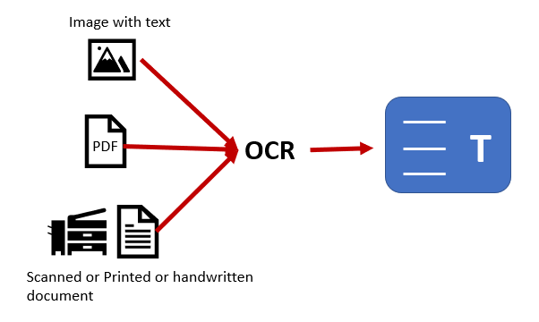
INTRODUCTION:
Optical Character Recognition is the technology used for converting the transcribed, handwritten or any printed text documents such as scanned pages, images taken by any camera or phone into the text data that can be edited and reused.
In other words, OCR takes a look on the photo of the text document (therefore it is called as "optical" process) and then recognizes the different alphabets, numbers or any other characters.
This sub process is called as character recognition, which is used to fetch the characters from the image, and then these characters will be converted to text sentences for further use.
Notes:
shreya start

Slide 7
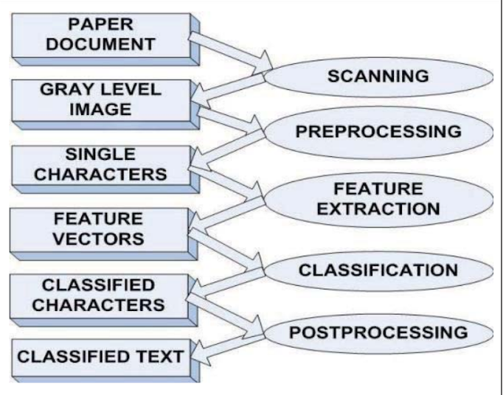
This figure shows the classic workflow model of OCR system that follows nine steps (excluding first and the last step) to extract the text from the document. These steps can be classified to main five steps that are, preprocessing, segmentation, feature extraction, classification and recognition.
Notes:
shreya

Slide 8
STATE OF THE ART WORK
AUTHOR’S NAME | TITLE | JOURNAL YEAR | KEY FEATURES
Saurabh Dome, Asha P Sathe | Optical Charater Recognition using Tesseract and Classification | AISSMS Institute of Information Technology, Pune, India. Mar 5-7, 2021 | This paper presents the design and procedure of the OCR WebApp, which consists of three sections that are: Image-to-Text, Real-time OCR , and Handwritten Text Recognition.
Karez Abdulwahhab Hamad , Mehmet Kaya | A Detailed Analysis of Optical Character Recognition Technology | International Journal of Applied Mathematics, Electronics and Computers-2019 | In this paper, Numerous algorithms, methods and techniques have been proposed to optical character recognition in scene imagery.
Notes:
shreya

Slide 9
STATE OF THE ART WORK
AUTHOR’S NAME | TITLE | JOURNAL YEAR | KEY FEATURES
Jaewoo Park; Eunji Lee; Yoonsik Kim; Isaac Kang | Multi-Lingual Optical Character Recognition System Using the Reinforcement Learning of Character Segmenter | Published in IEEE on Aug, 2016 | In this document, they presented a new multi-lingual Optical Character Recognition (OCR) system for scanned documents.
Vaibhav. V. Mainkar; Jyoti A. Katkar; Ajinkya B. Upade; Poonam | Handwritten Character Recognition to Obtain Editable Text | Published in IEEE on nov, 2014 | In this document, they developed an android application for character recognition to read the text from an image is a big area of research.
Notes:
shreya

Slide 10
STATE OF THE ART WORK
AUTHOR’S NAME | TITLE | JOURNAL YEAR | KEY FEATURES
Nafiz Arica & Fatos Tunay Yarman Vural | An overview of character recognition focused on off-line handwriting | June 2001, IEEE Transactions on Systems Man and Cybernetics Part C (Applications and Reviews) | This paper serves as a guide and update for readers working in the CR area. First, the historical evolution of CR systems is presented.
Chirag PatelAtul PatelDharmendra Patel | Optical Character Recognition by Open source OCR Tool Tesseract: A Case Study | International Journal Of Computer Applications- December 2022 Edition | This paper gives comparative study on commercial OCR tool Transym OCR by considering vehicle number plate as input.
Notes:
shreya end

Slide 11

How to extract data from structured, unstructured, handwritten documents and images?
PROBLEM
STATEMENT:
SOUTION: OCR
Notes:
nanu start

Slide 12
EXISTING SYSTEM
In the running world there is a growing demand for the users to convert the printed documents in to electronic documents for maintaining the security of their data. Hence the basic OCR system was invented to convert the data available on papers in to computer process able documents, So that the documents can be editable and reusable. The existing system/the previous system of OCR on a grid infrastructure is just OCR without grid functionality. That is the existing system deals with the homogeneous character recognition or character recognition of single languages.
Notes:
nanu

Slide 13
PROPOSED SYSTEM
Our proposed system is OCR which can extract text from different types of image formats like jpg, png and pdf too and can recognize mostly all languages. This proposed system also includes modules like Image to Audio conversion, giving the dimensions of images, it does alphabet screening, giving coordinates for images, and providing bounded rectangles for specific identification. Also, our project includes the conversion of images into PDF, HOCR and XML formats. This project can extract text from pdf also and display the pages in pdf. It also has the ability to extract the whole folder of images.
Notes:
nanu

Slide 14
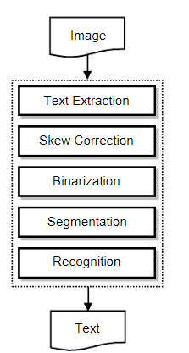
SYSTEM DESIGN (BLOCK DIAGRAM)
Notes:
shreya

Slide 15
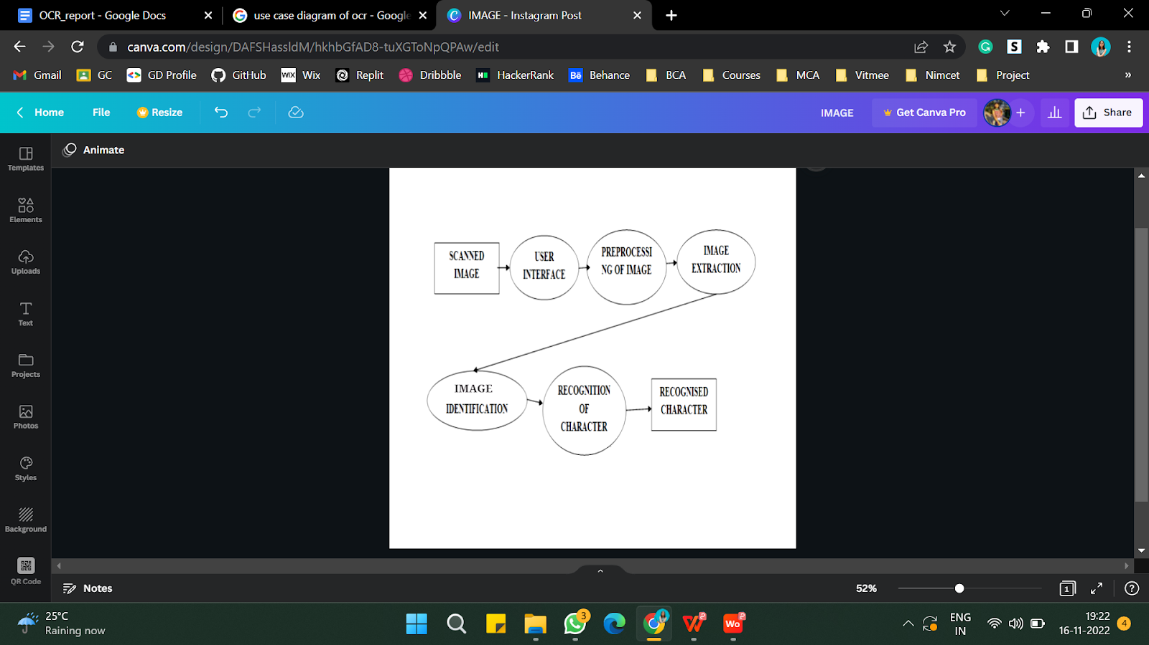
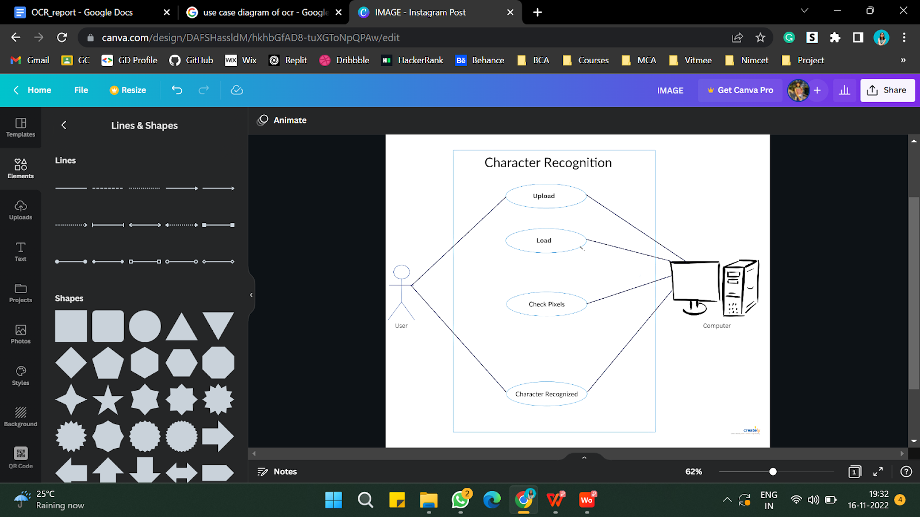
SYSTEM DESIGN(UML DIAGRAMS)
DATA FLOW DIAGRAM
USE CASE DIAGRAM
Notes:
nanu

Slide 16
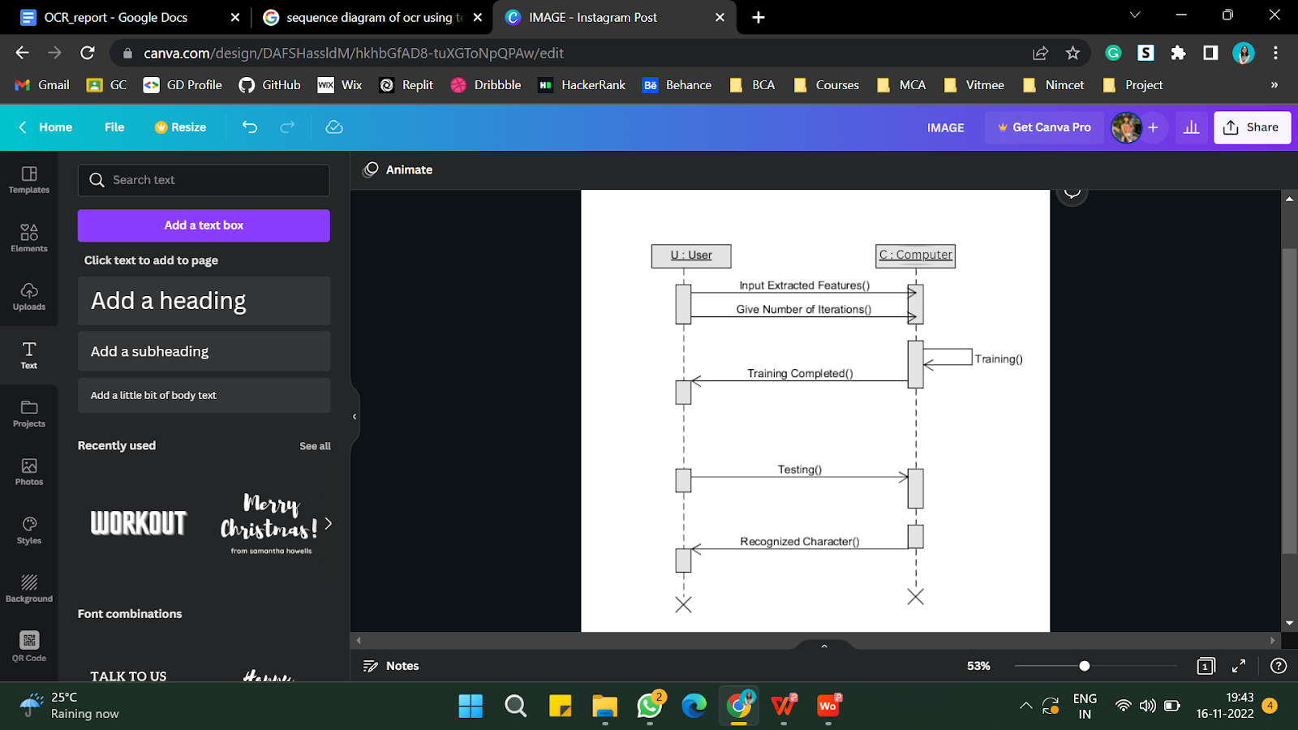
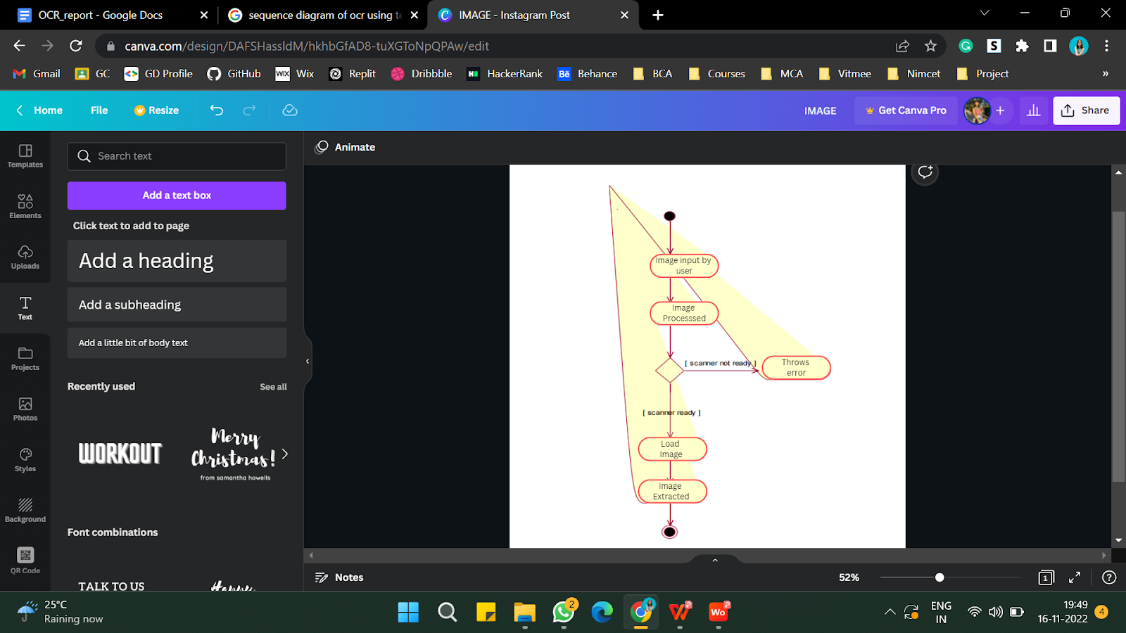
SYSTEM DESIGN(UML DIAGRAMS)
SEQUENCE DIAGRAM
ACTIVITY DIAGRAM
Notes:
nanu

Slide 17
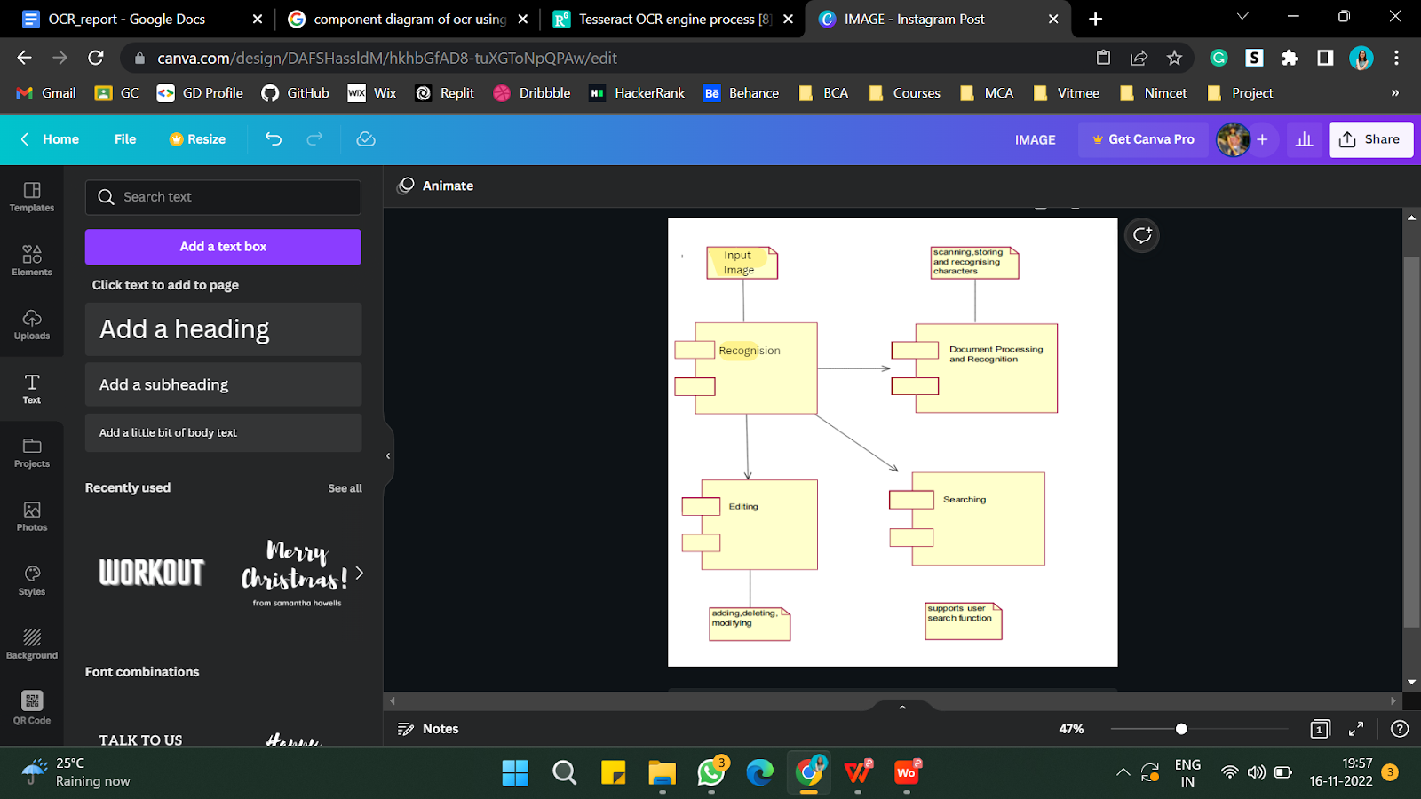
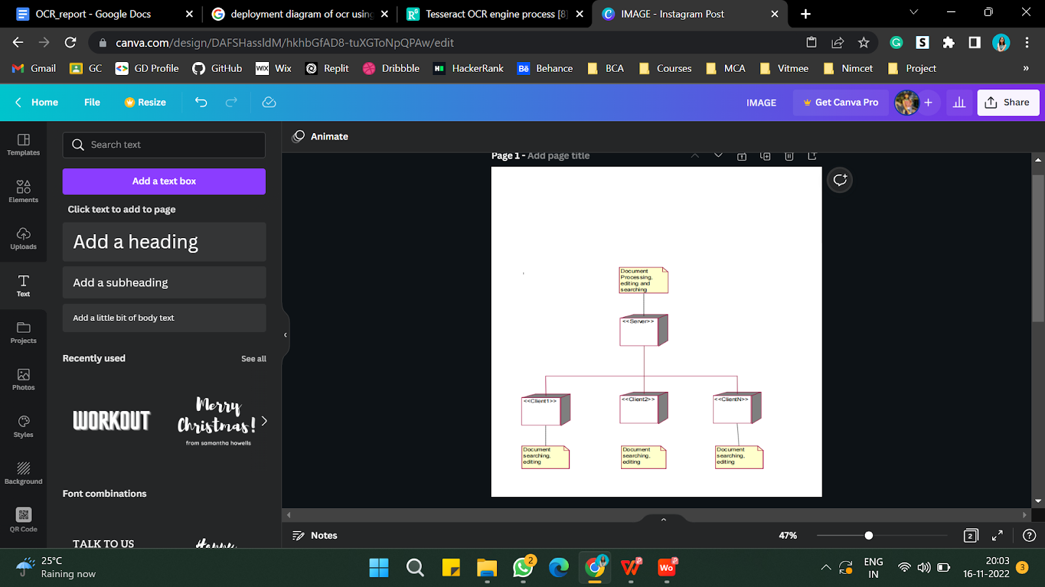
SYSTEM DESIGN(UML DIAGRAMS)
COMPONENT DIAGRAM
DEPLOYMENT DIAGRAM
Notes:
Nanu end

Slide 18
METHODOLOGY
Python: Following Python libraries are used in our project:
a) OpenCV: OpenCV is a library for different programming functions primarily that aimed to provide real-time computer vision. It is used to import and perform segmentation of the image as well as extract the image in our project.
b) Tesseract: Tesseract is a library, which provides Optical Character Recognition engine with support for the Unicode and has the ability to recognize more than 100 languages in-built. It can also be trained to recognize other languages as well.
c) Pytesseract: Python tesseract (pytesseract) is a wrapper module for tesseract-OCR-engine developed by the Google. Pytesseract can be installed in to your computer, if you have installed any python version greater than or equal to 3.0. Whenever you have installed tesseract, simply install this 3rd party module by a simple pip command and play around.
Notes:
shreya
OpenCV-Python is a library of Python designed to solve computer vision problems. Tesseract is an Optical Character Recognition tool (OCR) which can be used to extract written text from different types image files.
Python tesseract (pytesseract) is a wrapper module for tesseract-OCR-engine developed by the Google. An intermediate bridge which creates an interface btw python ocr and tesseract

Slide 19
SYSTEM REQUIREMENTS:
Following are the basic requirements (both hardware and software requirements) to run our project software:
Python 3
Min 4 GB free disk space
Min 4GB RAM,8GB recommended
Python, libraries
MS windows 7/8/10/11
Notes:
shreya

Slide 20
APPLICATIONS:
OCR can be utilized as any of the following applications:
Data entry for business documents, e.g. Cheques, passport, invoices, bank statements and receipt
Automatic Number Plate Recognition In airports, for passport recognition and information extraction.
Automatic insurance documents key information extraction
Traffic sign recognition
Extracting business card information into a contact list
More quickly make textual versions of printed documents, e.g. book scanning Make electronic images of printed documents searchable, e.g. Google Books.
Notes:
shreya

Slide 21
CONCLUSION:
What does the future hold for OCR? Given enough entrepreneurial designers and sufficient research and development dollars, OCR can become a powerful tool for future data entry applications. However, the limited availability of funds in a capital-short environment could restrict the growth of this technology. But, given the proper impetus and encouragement, a lot of benefits can be provided by the OCR system. They are:- The automated entry of data by OCR is one of the most attractive, labor reducing technology. The recognition of new font characters by the system is very easy and quick. We can edit the information of the documents more conveniently and we can reuse the edited information as and when required. The extension to software other than editing and searching is topic for future works.
Notes:
shreya

Slide 22
FUTURE WORK:
The Optical Character Recognition software can be enhanced in the future in different kinds of ways such as:
Training and recognition speeds can be increased greater and greater by making it more user-friendly.
As a future work we are planning to use OCR for such practical applications for daily personal use. We are planning to incorporate mobile devices with OCR in one OCR system.
UI Development: Better responsive UI with features such as drag-and-drop.
Tainting Model: Model will be trained with more amount of dataset to output higher accuracy.
Deploying: The WebApp will be deployed on a host and will be accessible on a domain to people to use as free and contribute-and-learn.
More accuracy and testing.
Notes:
shreya

Slide 23
REFERENCES:
2021 International Conference on Emerging Smart Computing and Informatics (ESCI) AISSMS Institute of Information Technology, Pune, India. Mar 5-7, 2021, Optical Charater Recognition using Tesseract and Classification
International Journal of Applied Mathematics, Electronics and Computers Advanced Technology and Science , A Detailed Analysis of Optical Character Recognition Technology
Compiter Vision and Deep Learning Resource Guide by Dr. Adrian Rosebrock from pyimagesearch
Jaewoo Park; Eunji Lee, Yoonsik Kim, Isaac Kang, Hyung Il Koo and Nam Ik Cho “Multi-Lingual Optical Character Recognition System Using the Reinforcement Learning of Character Segmenter,” in IEEE Access (Volume: 8).
Vaibhav. V. Mainkar, Jyoti A. Katkar, Ajinkya B. Upade, Poonam R. Pednekar, “Handwritten Character Recognition to Obtain Editable Text,” 2020 International Conference on Electronics and Sustainable Communication Systems (ICESC), pp. 599 – 602.
N. Arica and F. Yarman-Vural, An Overview of Character Recognition Focused on Offline Handwriting, IEEE Transactions on Systems, Man, and Cybernetics, Part C: Applications and Reviews, Vol. 31, No.2, pp. 216--233, 2001.
Patel C, Patel A, Patel D. Optical character recognition by open source OCR tool tesseract: A case study. International Journal of Computer Applications. 2012 Jan 1;55(10).
Abin M Sabu and Anto Sahaya Das, “A Survey on various Optical Character Recognition Techniques,” 2018 Conference on Emerging Devices and Smart Systems (ICEDSS)
https://github.com/tesseract-ocr/tesseract
https://www.thepythoncode.com/article/optical-character-recognition-pytesseract-python
https://pyimagesearch.com/2021/08/23/your-first-ocr-project-with-tesseract-and-python/
https://www.analyticsvidhya.com/blog/2021/06/optical-character-recognitionocr-with-tesseract-opencv-and-python/
Notes:
shreya end

Slide 24
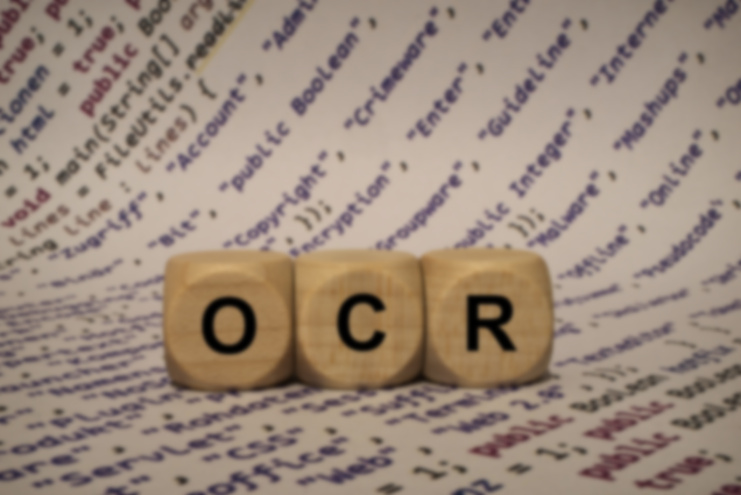

Notes:
shreya

